Slide 1
Crop Recommendation System
Group Members:
Shaikh Abdul Rafay (k21-3051)
Rayyan Ahmed (k21-3079)
Minal Alam (k21-3072)

Slide 2
Project Overview
Objective: Develop a system to recommend the best crops to grow based on user's city and preferences.
Data Source: https://aari.punjab.gov.pk/cropvarities
Technologies Used:
Python
Pandas
Tkinter for GUI
Numpy for arithmetic operations

Slide 3
Data Collection
Source: AARI Punjab's crop varieties page
Data: Information on seeds for crops including wheat, sugar cane, rice, groundnut, and cotton
Method: Web scraping to gather detailed attributes for each seed.

Slide 4
Challenges in Data Collection
Tailored Data Requirement: Difficulty in finding data specifically tailored for training a recommendation system.
Limited Attributes: Data may lack detailed attributes necessary for effective recommendation.
Data Quality: Ensuring the accuracy and reliability of the scraped data.
Data Preprocessing: Cleaning and structuring the scraped data for model training.

Slide 5
System Workflow
City Selection: User selects the city for cultivation.
Crop Recommendation: System suggests crops suitable for the city.
User Preferences: User inputs their preferences for attributes of the selected crop, such as Kernel Weight, protein%, etc.
Final Recommendation: The system recommends the crop variety with the highest similarity score, ensuring optimal yield and suitability for the user's needs.

Slide 6
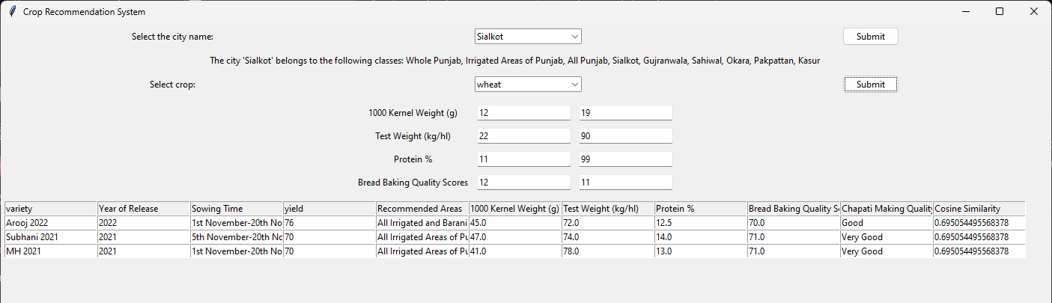
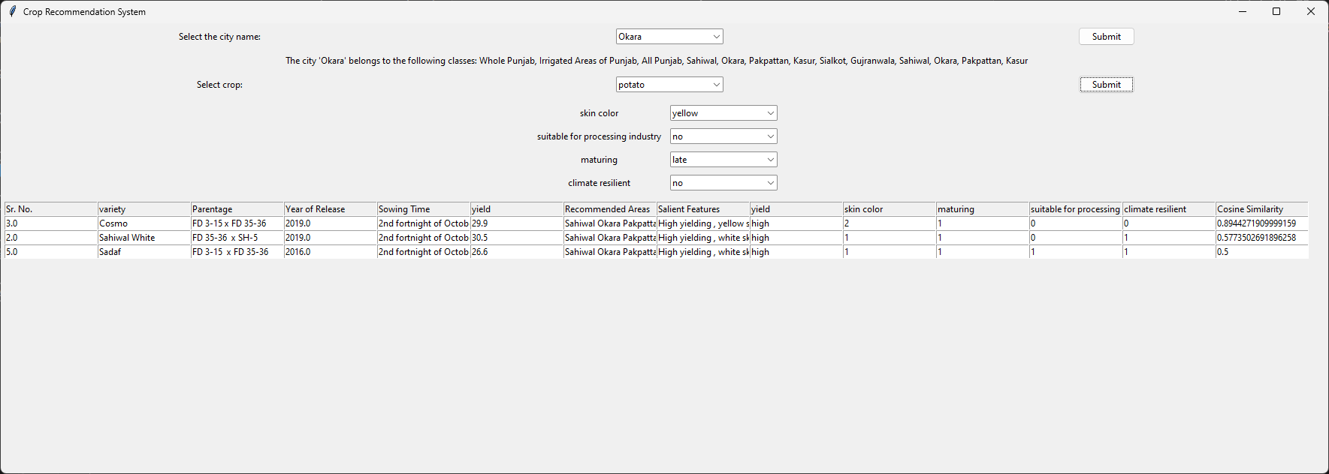
GUI

Slide 7
Future Work
Enhanced Data Collection:
Broader Data Sources: Integrate additional data sources for more comprehensive crop information.
Real-Time Data: Incorporate real-time weather and soil data to refine recommendations.
Model Improvement:
Advanced Algorithms: Explore machine learning and deep learning algorithms to enhance recommendation accuracy.
Personalization: Develop more personalized recommendations based on user history and preferences.
User Experience:
Mobile Application: Create a mobile-friendly version of the system for wider accessibility.
User Feedback Integration: Implement a feedback loop to continuously improve the recommendation system based on user input.
Partnerships:
Collaboration with Agricultural Experts: Work with agronomists and local farmers to validate and improve recommendations.
Government and NGOs: Partner with governmental and non-governmental organizations for data sharing and better outreach

